Slide 1
Wireless Network and Security
1. Components Of wireless networks
Security issues in wireless

Slide 2
Presentation Outline
Wireless Technology overview
The IEEE 802.11 WLAN Standards
Secure Wireless LANs
Migrating to Wireless LANs (Cutting the cord)

Slide 3
Wireless?
A wireless LAN or WLAN is a wireless local area network that uses radio waves as its carrier.
The last link with the users is wireless, to give a network connection to all users in a building or campus.
The backbone network usually uses cables

Slide 4
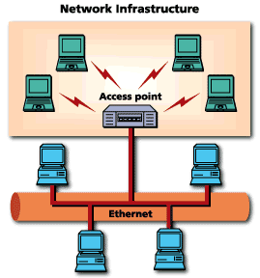
Common Topologies
The wireless LAN connects to a wired LAN
There is a need of an access point that bridges wireless LAN traffic into the wired LAN.
The access point (AP) can also act as a repeater for wireless nodes, effectively doubling the maximum possible distance between nodes.

Slide 5
Common Topologies
Complete Wireless Networks
The physical size of the network is determined by the maximum reliable propagation range of the radio signals.
Referred to as ad hoc networks
Are self-organizing networks without any centralized control
Suited for temporary situations such as meetings and conferences.

Slide 6
How do wireless LANs work?
Wireless LANs operate in almost the same way as
wired LANs, using the same networking protocols
and supporting the most of the same
applications.

Slide 7
How are WLANs Different?
They use specialized physical and data link protocols
They integrate into existing networks through access points which provide a bridging function
They let you stay connected as you roam from one coverage area to another
They have unique security considerations
They have specific interoperability requirements
They require different hardware
They offer performance that differs from wired LANs.

Slide 8
Physical and Data Link Layers
Physical Layer:
The wireless NIC takes frames of data from the link layer, scrambles the data in a predetermined way, then uses the modified data stream to modulate a radio carrier signal.
Data Link Layer:
Uses Carriers-Sense-Multiple-Access with Collision Avoidance (CSMA/CA).

Slide 9
Integration With Existing Networks
Wireless Access Points (APs) - a small device that bridges wireless traffic to your network.
Most access points bridge wireless LANs into Ethernet networks, but Token-Ring options are available as well.

Slide 10
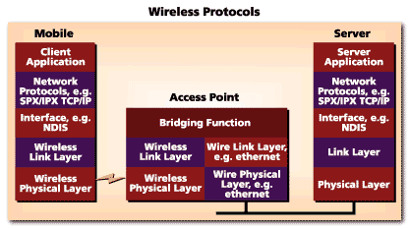
Integration With Existing Networks

Slide 11
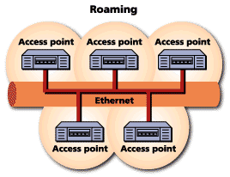
Roaming
Users maintain a continuous connection as they roam from one physical area to another
Mobile nodes automatically register with the new access point.
Methods: DHCP, Mobile IP
IEEE 802.11 standard does not
address roaming, you may need
to purchase equipment from one
vendor if your users need to roam
from one access point to another.

Slide 12
Security
In theory, spread spectrum radio signals are inherently difficult to decipher without knowing the exact hopping sequences or direct sequence codes used
The IEEE 802.11 standard specifies optional security called "Wired Equivalent Privacy" whose goal is that a wireless LAN offer privacy equivalent to that offered by a wired LAN. The standard also specifies optional authentication measures.

Slide 13
Interoperability
Before the IEEE 802.11 interoperability was based on cooperation between vendors.
IEEE 802.11 only standardizes the physical and medium access control layers.
Vendors must still work with each other to ensure their IEEE 802.11 implementations interoperate
Wireless Ethernet Compatibility Alliance (WECA) introduces the Wi-Fi Certification to ensure cross-vendor interoperability of 802.11b solutions

Slide 14
Hardware
PC Card, either with integral antenna or with external antenna/RF module.
ISA Card with external antenna connected by cable.
Handheld terminals
Access points

Slide 15
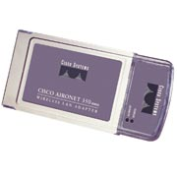
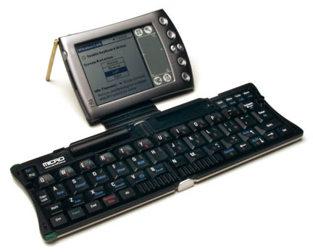
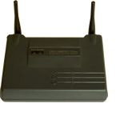
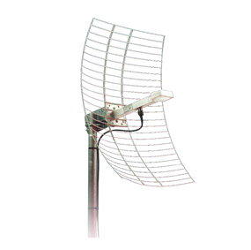
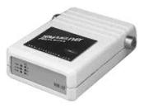
Hardware
CISCO Aironet 350 series
Wireless Handheld Terminal
Semi Parabolic Antenna
BreezeCOM AP

Slide 16
Performance
802.11a offers speeds with a theoretically maximum rate of 54Mbps in the 5 GHz band
802.11b offers speeds with a theoretically maximum rate of 11Mbps at in the 2.4 GHz spectrum band
802.11g is a new standard for data rates of up to a theoretical maximum of 54 Mbps at 2.4 GHz.

Slide 17
What is 802.11?
A family of wireless LAN (WLAN) specifications developed by a working group at the Institute of Electrical and Electronic Engineers (IEEE)
Defines standard for WLANs using the following four technologies
Frequency Hopping Spread Spectrum (FHSS)
Direct Sequence Spread Spectrum (DSSS)
Infrared (IR)
Orthogonal Frequency Division Multiplexing (OFDM)
Versions: 802.11a, 802.11b, 802.11g, 802.11e, 802.11f, 802.11i

Slide 18
802.11 - Transmission
Most wireless LAN products operate in unlicensed radio bands
2.4 GHz is most popular
Available in most parts of the world
No need for user licensing
Most wireless LANs use spread-spectrum radio
Resistant to interference, secure
Two popular methods
Frequency Hopping (FH)
Direct Sequence (DS)

Slide 19
Issues
In
Wireless Security

Slide 20
Current 802.11 Security
(as per the 1999 spec)
Authentication
Tied to association (session between station and AP)
Open system - all stations may associate
Shared key - stations must know secret
Integrity
Privacy

Slide 21
Current 802.11 Security
(as per the 1999 spec)
Authentication
Integrity - Integrity Check (IC) field
32 bit CRC in encrypted payload
Not separately keyed
Vulnerable to bit-flipping attacks
Privacy

Slide 22
Current 802.11 Security
(as per the 1999 spec)
Authentication
Integrity
Privacy - Wired Equivalent Privacy (WEP)
RC4 cipher (relies on XOR)
Up to 4 keys per station (40 bit or 104 bit)
Initialization Vector (IV)
24 bit extension to key
Provides some randomization to key
Unfortunately, keyspace is small!

Slide 23
Big WEP Attack - Weak IV
Say an AP constantly sends 1500 byte frames at 11 Mbps
Keyspace is exhausted in 5 hours
Will be quicker if packets are smaller
Original IV algorithms made things much worse
Some cards used same IV for multiple packets Some cards reset IV to 0 after initialization
Some cards increment IV by 1 after each packet
WEP+ fixed these “Weak IV” issues

Slide 24
Improving Security
Improve authentication
System wide common login
Improve integrity
Separate integrity key
Stronger integrity algorithm
Improve privacy
Increase keyspace size (make cracker analyze more data in order to recover key)
Per -user keys
Key rollover
Stronger privacy algorithm

Slide 25
802.11i and WPA
IEEE 802.11i - IEEE 802.11 task group “MAC enhancement for wireless security”
Wi-Fi Alliance WPA - subset of 802.11i
Compatible with earlier draft
Defined for BSS only
Defined for current hardware
WPA has two major components
Authentication
TKIP encryption

Slide 26
WPA
Authentication
802.1x (not 802.11x) - defined for both wired and wireless session establishment
EAP (Extensible Authentication Protocol) - generic wrapper for authentication traffic
EAP impact
Authentication is between laptop and server - AP is pretty clueless
Different auth methods, updating auth methods do not require upgrades on AP
Pre-Shared Key (PSK) - for SOHO networks

Slide 27
WPA
Temporal Key Integrity Protocol (TKIP)
Stronger privacy
Still uses RC-4 encryption
Key rollover (temporal key)
Stronger integrity
Message Integrity Code (MIC) - computed with own integrity algorithm (MICHAEL)
Separate integrity key
Integrity counter measures

Slide 28
802.11i
Additions over WPA
IBSS (ad-hoc mode) authentication - what does a security context mean without a trusted third party? Is PSK enough?
Counter-Mode/CBC-MAC Protocol (CCMP)
Privacy: AES-CCM (128 bit key)
Integrity: CBC-MAC

Slide 29
802.11i criticisms
Does not secure 802.11 management control and action frames
Disassociate, output power, etc.
Fundamental dilemma: does 802.11i secure
1. Traffic carried by the network?
2. Network elements themselves?

