Slide 1
Module 4
Security Architecture and Models
Chapter 1: System and Application Security

Slide 2
Chapter 1: System and Application Security
1.1 Designing Secure Operating System
1.2 Controls to enforce security services
1.3 Information Security Models

Slide 3
Trusted OS Design
OS is a complex system
difficult to design
Adding the responsibility of security enforcement makes it even more difficult
Clear mapping from security requirements to the design
Design must be checked using formal reviews or simulation
Requirements → design → testing

Slide 4
Security Design Principles
Least privilege
users, programs, fewest privilege possible
Economy of mechanism
small, simple, straight forward
Open design
extensive public scrutiny
Complete mediation
every attempt must be checked

Slide 5
Security Design Principles
Permission based
denial of access is the default
Separation of privilege
more than one condition
Least common mechanism
the risk of sharing
Ease of use
unlikely to be avoided

Slide 6
OS Functions

Slide 7
Security features in ordinary OS
Authentication of users
password comparison
Protection of memory
user space, paging, segmentations
File and I/O device access control
access control matrix
Allocation & access control to general objects
table lookup

Slide 8
Security features in ordinary OS
Enforcement of sharing
integrity, consistency
Fair service
no starvation
Interprocess communication & synchronization
table lookup
Protection of OS protection data
encryption, hardware control, isolation

Slide 9
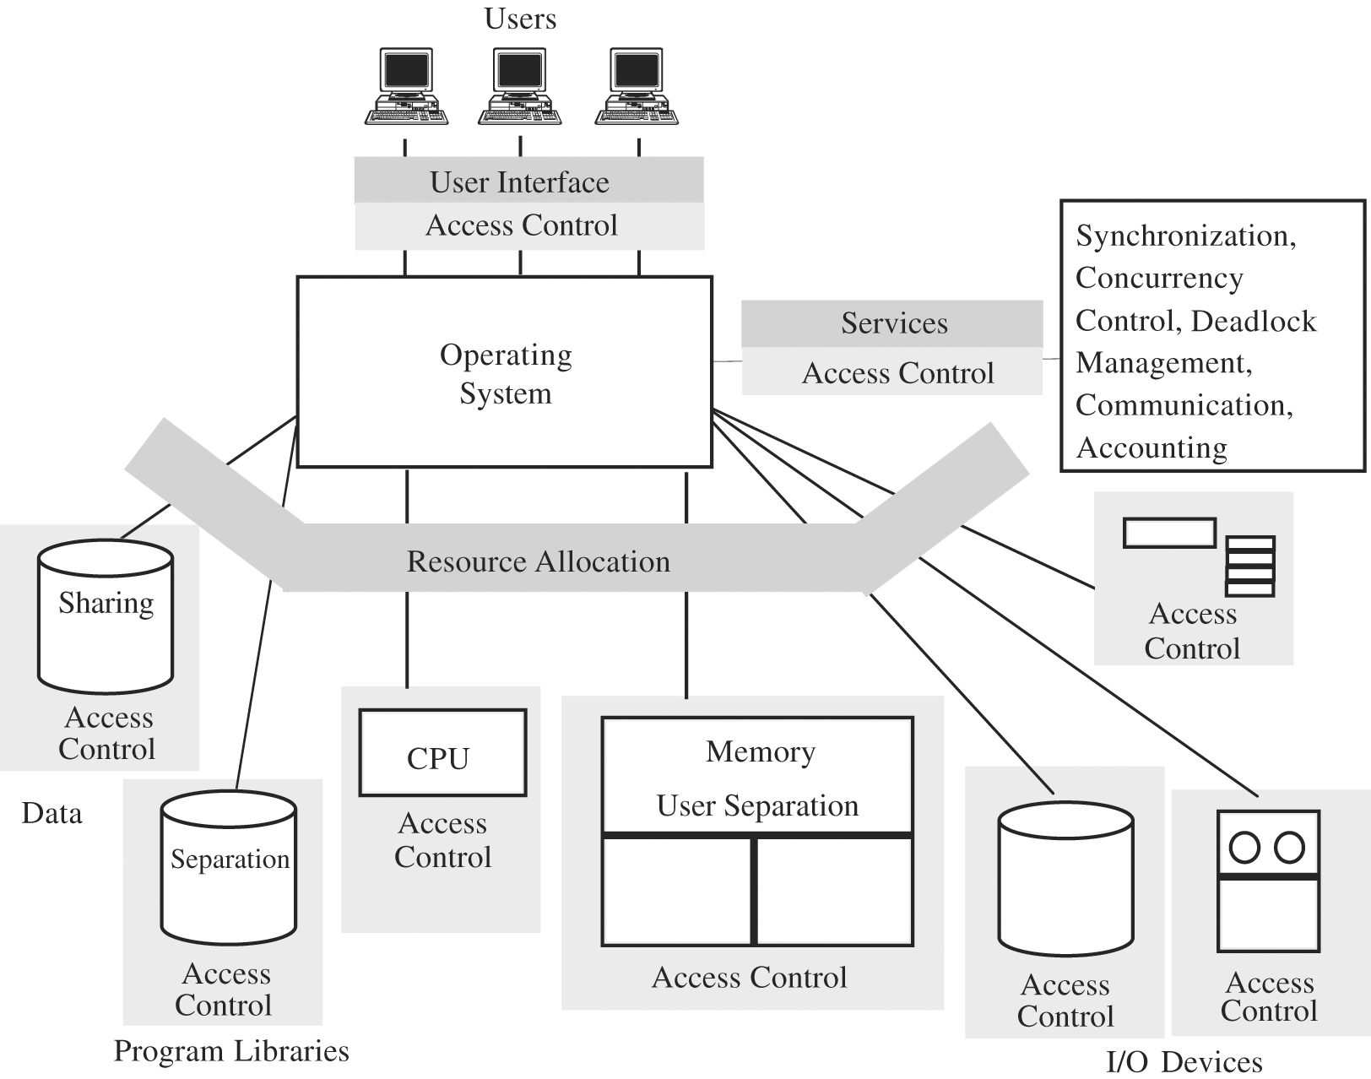
Trusted OS Functions

Slide 10
Security features of Trusted OS
Identification and Authentication
Mandatory and Discretionary Access Control
Object reuse protection
Complete mediation (all accesses are checked)
Trusted path
Accountability and Audit (security log)
Audit log reduction
Intrusion detection (patterns of normal system usages, anomalies)

Slide 11
Kernel
OS part that performs lowest level functions
User tasks
OS
OS Kernel
Hardware

Slide 12
Security Kernel
responsible for enforcing security mechanisms of the entire OS
Coverage
ensure that every access is checked
Separation
security mechanisms are isolated from the rest of OS and from user space → easier to protect
Unity
all security mechanisms are performed by a single set of code → easier to trace problems

Slide 13
Security Kernel
Modifiability
security mechanism changes are easier to make and test
Compactness
relatively small
Verifiability
formal methods , all situations are covered

Slide 14
Reference Monitor
portion of a security kernel that controls accesses to objects
Collection of access controls for
Devices, Files, Memory, Interprocess
communication, Other objects
It must be
Always invoked when any object is accessed
Small enough
analysis, testing
Tamperproof
O
O
O
Gate
S
S
S

Slide 15
Trusted Computing Base (TCB)
Everything in the trusted OS necessary to enforce security policy
System element on which security enforcement depends:
Hardware
processors, memory, registers, and I/O devices
Processes
separate and protect security-critical processes

Slide 16
Trusted Computing Base (TCB)
System element on which security enforcement depends (cont):
Primitive files
security access control database, identification/authentication data
Protected memory
reference monitor can be protected against tampering
Interprocess communication
e.g., reference monitor can invoke and pass data securely to audit routine

Slide 17
TCB and Non-TCB Code
Applications
Utilities
User request interpreter
…
Segmentation, paging, memory management
Non-TCB
Primitive I/O
Basic Operations
Clocks, timing
Interrupt handling
Hardware:registers memory
Capabilities
TCB

Slide 18
TCB monitors basic interactions
Process activation
Execution domain switching
Memory Protection
I/O operation

Slide 19
Combined Security Kernel / OS System
OS Kernel:
- HW interactions
- Access control
User tasks
OS
OS Kernel
Hardware
OS:
Resource allocation
Sharing
Access control
Authentication functions
Security activity

Slide 20
Separate Security Kernel
Security Kernel:
Access control
Authentication functions
User tasks
OS
Security Kernel
Hardware
OS:
Resource allocation
Sharing
Hardware interactions

Slide 21
Separation
Physical Separation
Temporal Separation
Cryptographic Separation
Logical separation (isolation)

Slide 22
Virtualization
OS emulates or simulates a collection of a computer system’s resources
Virtual Machine: Collection of real or simulated hardware facilities
processor, memory, I/O devices

Slide 23
Virtual machine
Virtual
Machine
User 1
Virtual
Machine
User 2
Virtual
Machine
User 3
Real OS
Real System Resources

Slide 24
IBM MVS/ESA
Virtualization is used to provide logical separation that gives the user the impression of physical separation
Each user feels that he/she has a separate machine
Paging System
Each user’s virtual memory space can be as large as the total addressable space

Slide 25
Layered OS
User processes
Compilers, database
Utility functions
OS
File system, device allocation
Scheduling, sharing, MM
Synchronization, allocation
OS kernel
Security functions
Security kernel
Hardware

Slide 26
Modules operating in Different Layers
Least trusted code
Most
trusted code
Data update
Data comparison
User ID lookup
User interface
User Authentication module

Slide 27
Assurance
Testing
based on the actual product being evaluated,
not on abstraction
Verification
each of the system’s functions works correctly
Validation
developer is building the right product
according to the specification

Slide 28
Testing
Observable effects versus internal structure
Can demonstrate existence of a problem,
but passing tests does not imply absence of any
Hard to achieve adequate test coverage within reasonable time
inputs & internal states
hard to keep track of all states
Penetrating Testing
tiger team analysis, ethical hacking
Team of experts in design of OS tries to crack system

Slide 29
Formal verification
The most rigorous method
Rules of mathematical logic to demonstrate that a system has certain security property
Proving a Theorem
Time consuming
Complex process

Slide 30
Example: find minimum
Entry
min ← A[1]
i ← 1
i ← i + 1
i > n
yes
Exit
no
yes
min < A[i]
no
min ← A[i]

Slide 31
Finding the minimum value
Assertions
P: n > 0 Q: n > 0 and
1 ≤ i ≤ n and
min ≤ A[1]
R: n > 0 and S: n > 0 and
1 ≤ i ≤ n and i = n + 1 and
for all j 1 ≤ j ≤ i -1 for all j 1 ≤ j ≤ i -1
min ≤ A[j] min ≤ A[j]

Slide 32
Validation
Requirements checking
system does things it should do
also, system does not do things it is not supposed to do
Design and code reviews
traceability from each requirement to design and code components
System testing
data expected from reading the requirement document can be confirmed in the actual running of the system

Slide 33
Evaluation
Review: requirements, design, implementation, assurance
US “Orange Book” Evaluation
Trusted Computer System Evaluation Criteria (TCSEC)
European ITSEC Evaluation
Information Technology Security Evaluation Criteria
US Combined Federal Criteria
1992 jointly buy NIST and NSA

Slide 34
Enforcing
Policies
Security
Rahul Gera

Slide 35
Brief
overview
 Security policies and Execution
Monitoring.
 Policies that can be enforced using
 An automata based formalism for specifying those security policies.
EM.
 Mechanisms for enforcing policies
by the automata.
defined
Enforceable Security Policies
by Fred Schneider
2

Slide 36
Security
Policy
 The paper uses the definition of a security policy
as “A security policy defines execution that, for one reason or another, has been deemed unacceptable”.
access control :- restrict what operations principals can perform on objects.
information flow :- restrict what principals can infer about objects from observing system behavior.
availability:- restrict principals from denying others the use of a resource.
Enforceable Security Policies
by Fred Schneider
3

Slide 37
More application Specific Security
policies
 The paper also tries
specific applications which a policy could
to address more
like eCommerce in say that if a customer
pays
does
for a service then in no execution
the
seller not provide
the
service.
Enforceable Security Policies
by Fred Schneider
4

Slide 38
Execution
Monitoring.
 The paper talks about an enforcement
mechanisms that work by monitoring execution steps of some system, called the target, and terminating the target’s
execution if it is about to violate
security policy being enforced.
the
Enforceable Security Policies
by Fred Schneider
5

Slide 39
What
are
bounds
on
EM
 Targets may be objects, modules,
processes, subsystems, or entire systems.
 The execution steps monitored may range from fine-grained actions (such as memory accesses) to higher-level operations (such
as method calls) to operations that
the security-configuration and thus subsequent execution.
change
restrict
Enforceable Security Policies
by Fred Schneider
6

Slide 40
Non
EM
mechanisms

Mechanisms that use more information than would be available only from observing the steps of a target’s execution are, by definition, excluded from EM.
Information provided to an EM mechanism is thus insufficient to predict future steps the target might take, alternative possible executions, or all possible target executions.
Compilers and theorem-provers, which analyze a static
representation of a target to deduce information about all of its
possible executions, are not EM mechanisms.
Mechanisms that modify a target before executing it. Although, these can be studied further IF The modified target is equivalent to the original, except for aborting executions that violate the security policy of interest. A definition for equivalent is thus required to analyze this class of mechanisms.



Enforceable Security Policies
by Fred Schneider
7

Slide 41
CHARACTERIZING EM
ENFORCEMENT MECHANISMS
ψ
denotes a universe of all possible finite

and infinite execution sequences.
 A target S defines
a subset
∑_{S}
of
of
ψ
corresponding
to
the executions
S.
Enforceable Security Policies
by Fred Schneider
8

Slide 42
Definition
is
terms
of
ψ
 Definition of Security Policy: A security
policy is specified by giving
sets of executions. A target
a predicate on
S satisfies
security
true.
policy
P
if
and
only
if
P( ∑ )
equals
S
Enforceable Security Policies
by Fred Schneider
9

Slide 43
 But given a security
of executions A and
policy P and two sets
B.
if
P(A) is true and B
is
a subset of
information
A does
flow.
not
imply
P(B)
is
true.
E.g.
Enforceable Security Policies
by Fred Schneider
10

Slide 44
Safety
Property
 A set of executions is called a property if set
membership is determined by each element alone and not by other members of the set.
 As a result we cant categories information flow as a it cant be defined in the isolation of a single execution.
 Also,
its
not



possible to enforce a policy in which
P^ (A) is true
But P^(A’) is false
A’ is the prefix to A which is some finite or infinite execution.
Enforceable Security Policies
by Fred Schneider
11

Slide 45
Safety
Property
Enforceable Security Policies
by Fred Schneider
12

Slide 46
 Non EM-Enforceable Security Policies: If the
set of executions for a security policy P is not
safety property, then an enforcement mechanism from EM does not exist for P.
 This enables us to say that if EM enforces P’
and P’ -> P then EM enforces P.
a
 And an aggregate of policies can
conjunction of individual policies.
be taken as
a
Enforceable Security Policies
by Fred Schneider
13

Slide 47
Policies we
started
with

Access control defines safety properties. The set of proscribed partial
executions contains those partial executions ending with an unacceptable
operation being attempted.
Information flow does not define sets that are properties, so it does not
define sets that are safety properties. Not being safety properties, there are
no EM enforcement mechanisms for exactly this policy.
Availability:- if taken to mean that no principal is forever denied use of
some given resource, is not a safety property as any partial execution can
be extended in a way that allows a principal to access the resource, so the
defining set of proscribed partial executions that every safety property must
have is absent. If availability is defined to rule out all denials in excess of
MWT seconds (for some predefined Maximum Waiting Time parameter
MWT). This is a safety property; the defining set of partial executions
contains prefixes ending in intervals that exceed MWT seconds during
which a principal is denied use of a resource.


Enforceable Security Policies
by Fred Schneider
14

Slide 48
Security
Automata
Enforceable Security Policies
by Fred Schneider
15

Slide 49
The
guard
and
the
Command.
Enforceable Security Policies
by Fred Schneider
16

Slide 50
Computer Security Models
Two fundamental computer security facts
All complex software systems have eventually revealed flaws or bugs that need to be fixed
It is extraordinarily difficult to build computer hardware/software not vulnerable to security attacks

Slide 51
Confidentiality Policy
Goal: prevent the unauthorized disclosure of information
Deals with information flow
Integrity incidental
Multi-level security models are best-known examples
Bell-LaPadula Model basis for many, or most, of these

Slide 52
Formal Security Models
Problems involved both design and implementation led to development of formal security models
Initially funded by US Department of Defense
Bell-LaPadula (BLP) model very influential

Slide 53
Bell-LaPadula (BLP) Model
Security levels arranged in linear ordering
Top Secret: highest
Secret
Confidential
Unclassified: lowest
Levels consist of security clearance L(s)
Objects have security classification L(o)

Slide 54
Bell-LaPadula (BLP) Model
Developed in 1970s
Formal model for access control
Subjects and objects are assigned a security class
Form a hierarchy and are referred to as security levels
A subject has a security clearance
An object has a security classification
Security classes control the manner by which a subject may access an object
Notes:
The BLP model was developed in the 1970s as a formal model for access control. The model relied on the access control concept described in Chapter 4 (e.g., Figure 4.4). In the model, each subject and each object is assigned a security class. In the simplest formulation, security classes form a strict hierarchy and are referred to as security levels. One example is the U.S. military classification scheme:
top secret > secret > confidential > unclassified
This concept is equally applicable in other areas, where information can be organized into gross categories and users can be granted clearances to access certain categories of data. For example, the highest level of security might be for strategic corporate planning documents and data, accessible by only corporate officers and their staff; next might come sensitive financial and personnel data, accessible only by administration personnel, corporate officers, and so on.
A subject is said to have a security clearance of a given level; an object is said to have a security classification of a given level. The security classes control the manner by which a subject may access an object. The model defined four access modes, although the authors pointed out that in specific implementation environments, a different set of modes might be used. The modes are: read, append, write, execute.

Slide 55
A BLP Example
Security level | Subject | Object
Top Secret | Tamara | Personnel Files
Secret | Samuel | E-Mail Files
Confidential | Claire | Activity Logs
Unclassified | James | Telephone Lists
Tamara can read all files
Claire cannot read Personnel or E-Mail Files
James can only read Telephone Lists

Slide 56
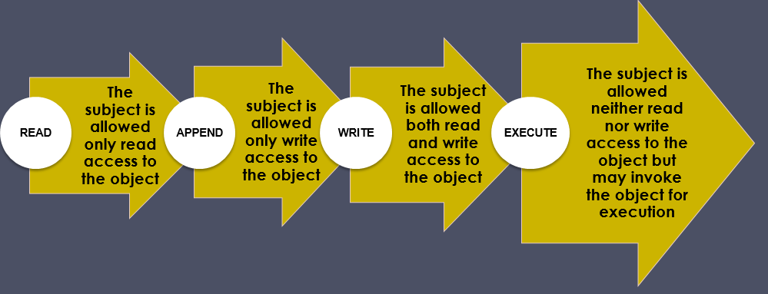
Access Privileges

Slide 57
Multilevel Security
Multiple levels of security and data
Subject at a high level may not convey info to a subject at a non-comparable level:
No read up (ss-property): a subj can only read an obj of less or equal sec level
No write down (*-property): a subj can only write into an obj of greater or equal sec level
Notes:
The BLP model was developed in the 1970s as a formal model for access control. The model relied on the access control concept described in Chapter 4 (e.g., Figure 4.4). In the model, each subject and each object is assigned a security class. In the simplest formulation, security classes form a strict hierarchy and are referred to as security levels. One example is the U.S. military classification scheme:
top secret > secret > confidential > unclassified
This concept is equally applicable in other areas, where information can be organized into gross categories and users can be granted clearances to access certain categories of data. For example, the highest level of security might be for strategic corporate planning documents and data, accessible by only corporate officers and their staff; next might come sensitive financial and personnel data, accessible only by administration personnel, corporate officers, and so on.
A subject is said to have a security clearance of a given level; an object is said to have a security classification of a given level. The security classes control the manner by which a subject may access an object. The model defined four access modes, although the authors pointed out that in specific implementation environments, a different set of modes might be used. The modes are: read, append, write, execute.

Slide 58
BLP Formal Description
Based on current state of system (b, M, f, H):
Current access set b (subj, objs, access-mode); it is the current access (not permanent)
Access matrix M (same as before)
Level function f: assigns sec level to each subj and obj; a subject may operate at that or lower level
Hierarchy H: a directed tree whose nodes are objs:
Sec level of an obj must dominate (must be greater than) its parents
Notes:
The BLP model is based on the current state of the system (b, M, f, H), defined as:
• Current access set b: a set of triples of the form (subject, object, access-mode).
• Access matrix M: has structure indicated in Chapter 4
• Level function f: assigns a security level to each subject and object.
• Hierarchy H: a directed rooted tree whose nodes are objects in the system. The security level of an object must dominate the security level of its parent.
For every subject S_{i} and every object O_{j}, the three BLP properties:
• ss-property: every triple (S_{i}, O_{j}, read) in access set b has property f_{c}(S_{i}) ≥ f_{o}(O_{j}).
• *-property: every triple (S_{i}, O_{j}, append) in b has the property f_{c}(S_{i}) ≤ f_{o}(O_{j}); and every triple (S_{i}, O_{j}, write) in b has the property f_{c}(S_{i}) = f_{o}(O_{j}).
• ds-property: if (S_{i}, O_{j}, A_{x}) is a current access (is in b), then access mode A_{x} is recorded in the (S_{i}, O_{j}) element of M. That is, (S_{i}, O_{j}, A_{x}) implies that A_{x} ∈ M[S_{i}, O_{j}].
These three properties can be used to define a secure system, characterized by:
1. every element of b satisfies the three properties.
2. is changed by any operation that changes any components of (b, M, f, H).
3. remains secure so long as any state change does not violate the three properties.
[BELL76] shows how these can be expressed as theorems using the formal model. Further, given an actual design or implementation, it is theoretically possible to prove the system secure by proving that any action that affects the state of the system satisfies the three properties. But in practice rarely can develop such a proof.

Slide 59
BLP Properties
Three BLP properties: (c = current)
ss-property: (S_{i}, O_{j}, read) has f_{c}(S_{i}) ≥ f_{o}(O_{j})
*-property: (S_{i}, O_{j}, append) has f_{c}(S_{i}) ≤ f_{o}(O_{j}) and
(S_{i}, O_{j}, write) has f_{c}(S_{i}) = f_{o}(O_{j})
ds-property: (S_{i}, O_{j}, A_{x}) implies A_{x} ∈ M[Si,Oj]
BLP give formal theorems
Theoretically possible to prove system is secure

Slide 60
BLP Operations
get access: add (subj, obj, access-mode) to b
used by a subj to initiate an access to an object
release access: remove (subj, obj, access-mode)
change object level
change current level
give access permission: Add an access mode to M
used by a subj to grant access to on an obj
rescind access permission: reverse of 5
create an object
delete a group of objects
Notes:
The BLP model includes a set of rules based on abstract operations that change the state of the system. Each rule is governed by the BLP three properties, and are:
1. Get access: Add a triple (subject, object, access-mode) to the current access set b. Used by a subject to initiate access to an object in the requested mode.
2. Release access: Remove a triple (subject, object, access-mode) from the current access set b. Used to release previously initiated access.
3. Change object level: Change the value of f_{o}(O_{j}) for some object O_{j}. Used by a subject to alter the security level of an object.
4. Change current level: Change the value of f_{c}(S_{i}) for some subject S_{i}. Used by a subject to alter the security level of a subject.
5. Give access permission: Add access mode to some entry of the access permission matrix M. Used by a subject to grant an access mode on an object to another subject.
6. Rescind access permission: Delete an access mode from some entry of M. Used by a subject to revoke an access previously granted.
7. Create an object: Attach an object to the current tree structure H as a leaf. Used to create a new object or activate an object that has previously been defined by is inactive because it has not been inserted into H.
8. Delete a group of objects: Detach from H an object and all other objects beneath it in the hierarchy. This renders the group of objects inactive. This operation may also modify the current access set b because all accesses to the object are released.
Rules 1 and 2 alter the current access; rules 3 and 4 alter the level functions; rules 5 and 6 alter access permission; and rules 7 and 8 alter the hierarchy.

Slide 61
BLP Example
A role-based access control system
Two users: Carla (student) and Dirk (teacher)
Carla (Class: s)
Dirk (Class: T); can also login as a students thus (Class: s)
A student role has a lower security clearance
A teacher role has a higher security clearance
Notes:
The BLP model includes a set of rules based on abstract operations that change the state of the system. Each rule is governed by the BLP three properties, and are:
1. Get access: Add a triple (subject, object, access-mode) to the current access set b. Used by a subject to initiate access to an object in the requested mode.
2. Release access: Remove a triple (subject, object, access-mode) from the current access set b. Used to release previously initiated access.
3. Change object level: Change the value of f_{o}(O_{j}) for some object O_{j}. Used by a subject to alter the security level of an object.
4. Change current level: Change the value of f_{c}(S_{i}) for some subject S_{i}. Used by a subject to alter the security level of a subject.
5. Give access permission: Add access mode to some entry of the access permission matrix M. Used by a subject to grant an access mode on an object to another subject.
6. Rescind access permission: Delete an access mode from some entry of M. Used by a subject to revoke an access previously granted.
7. Create an object: Attach an object to the current tree structure H as a leaf. Used to create a new object or activate an object that has previously been defined by is inactive because it has not been inserted into H.
8. Delete a group of objects: Detach from H an object and all other objects beneath it in the hierarchy. This renders the group of objects inactive. This operation may also modify the current access set b because all accesses to the object are released.
Rules 1 and 2 alter the current access; rules 3 and 4 alter the level functions; rules 5 and 6 alter access permission; and rules 7 and 8 alter the hierarchy.

Slide 62
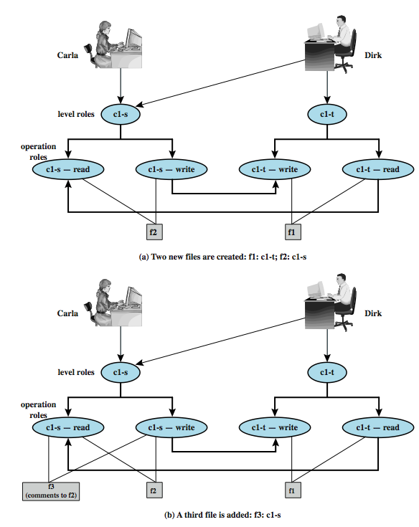
BLP Example
Dirk creates f1; Carla creates f2
Carla can read/write to f2
Carla can’t read f1
Dirk can read/write f1
Dirk can read f2 (if perm)
Dirk can read/write f2 only as a stu
Dirk reads f2; want create f3 (comments)
Dirk signs in as a stu (so Carla can read)
As a teacher, Dirk cannot create a
file at stu classification
Notes:
An example illustrates the operation of the BLP model, and also highlights a practical issue that must be addressed. We assume a role-based access control system. Carla and Dirk are users of the system. Carla is a student (s) in course c1. Dirk is a teacher (t) in course c1, but may also access the system as a student; thus two roles are assigned to Dirk: Carla: (c1-s); and Dirk: (c1-t), (c1-s).
The student role is assigned a lower security clearance and the teacher role a higher security clearance. Let us look at some possible actions:
1. Dirk creates a new file f1 as c1-t; Carla creates file f2 as c1-s (Figure 10.2a). Carla can read and write to f2, but cannot read f1, because it is at a higher classification level (teacher level). In the c1-t role, Dirk can read and write f1 and can read f2 if Carla grants access to f2. However, in this role, Dirk cannot write f2 because of the *-property; neither Dirk nor a Trojan horse on his behalf can downgrade data from the teacher level to the student level. Only if Dirk logs in as a student can he create a c1-s file or write to an existing c1-s file, such as f2. In the student role, Dirk can also read f2.
2. Dirk reads f2 and wants to create a new file with comments to Carla as feedback. Dirk must sign in student role c1-s to create f3 so that it can be accessed by Carla (Figure 10.2b). In a teacher role, Dirk cannot create a file at a student classification level.
continued next slide …

Slide 63
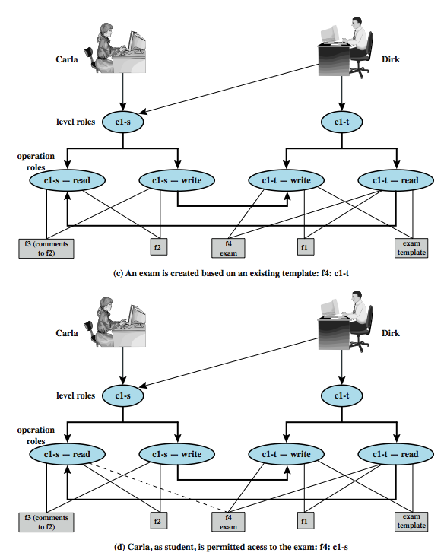
BLP Example cont.
Dirk as a teacher creates exam (f4)
Must log in as a teacher to read
template
Dirk wants to give Carla access to read f4
Dirk can’t do that; an admin must do
An admin downgrades f4 class to c1-s
Notes:
The example continues ….
3. Dirk creates an exam based on an existing template file store at level c1-t. Dirk must log in as c1-t to read the template and the file he creates (f4) must also be at the teacher level (Figure 10.2c).
4. Dirk wants Carla to take the exam and so must provide her with read access. However, such access would violate the ss-property. Dirk must downgrade the classification of f4 from c1-t to c1-s. Dirk cannot do this in the c1-t role because this would violate the *-property. Therefore, a security administrator (possibly Dirk in this role) must have downgrade authority and must be able to perform the downgrade outside the BLP model. The dotted line in Figure 10.2d connecting f4 with c1-s-read indicates that this connection has not been generated by the default BLP rules but by a system operation.
continued next slide …

Slide 64
BLP Example cont.
Carla writes answers to f5 (at c1-t level)
-- An example of write up
Dirk can read f5
Notes:
The example continues ….
5. Carla writes the answers to the exam into a file f5. She creates the file at level c1-t so that only Dirk can read the file. This is an example of writing up, which is not forbidden by the BLP rules. Carla can still see her answers at her workstation but cannot access f5 for reading.
This discussion illustrates some critical practical limitations of the BLP model. First, as noted in step 4, the BLP model has no provision to manage the “downgrade” of objects, even though the requirements for multilevel security recognize that such a flow of information may be required, provided it reflects the will of an authorized user. Hence, any practical implementation of a multilevel system has to support such a process in a controlled and monitored manner. Related to this is another concern. A subject constrained by the BLP model can only be “editing” (reading and writing) a file at one security level while also viewing files at the same or lower levels. If the new document consolidates information from a range of sources and levels, some of that information is now classified at a higher level than it was originally.This is known as classification creep, and is a well-known concern with multilevel information.
While the BLP model could in theory lay the foundations for secure computing within a single administration realm environment, there are some important limitations to it: an incompatibility of confidentiality and integrity within a single MLS system; and the so called cooperating conspirator problem in the presence of covert channels. In essence, the BLP model effectively breaks down when (untrusted) low classified executable data are allowed to be executed by a high clearance (trusted) subject.

Slide 65
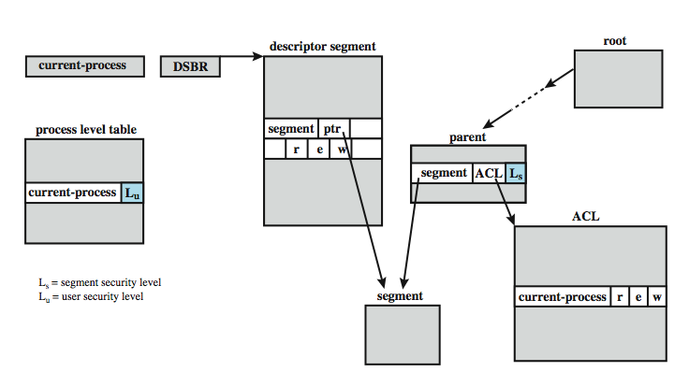
MULTICS Example
Notes:
There is an implementation of MLS on the Multics operating system, a time-sharing operating system developed at MIT known as Project MAC (multiple-access computers) in the 1960s. Multics was not just years but decades ahead of its time. Both memory management and the file system in Multics are based on segments. Virtual memory is segmented. On most hardware, paging is also used. The working space of a process is in a segment, and a process may create data segments. Each file in the file system is a segment. Thus, the OS uses the same mechanism to load a data segment from virtual memory into main memory and to load a file from virtual memory into main memory. Segments are arranged hierarchically, from a root directory down to individual segments. Multics manages the virtual address space by means of a descriptor segment, associated with a process, and which has one entry for each segment in virtual memory accessible by this process. The descriptor entry includes a pointer to the start of the segment in virtual memory plus protection information, in the form of read, write, and execute bits, which may be individually set to ON or OFF, derived from the access control list for the segment. For MLS, two additional features are required. A process level table includes an entry of each active process, and the entry indicates the security clearance of the process. Associated with each segment is a security level, stored in the parent directory segment of the segment in question. Corresponding to the security state of the BLP model (b, M, f, H) is a set of Multics data structures (Figure 10.3). With these, Multics can enforce discretionary and mandatory access control. When a process attempts an access to a segment, it must have the desired access permission as specified by the access control list. Also, its security clearance is compared to the security classification of the segment to be accessed to determine if the simple security rule and *-security rule are satisfied.

Slide 66
BLP Categories
Expand the model to add categories to each security classification
Objects placed in multiple categories
Based on “need to know” principle
Example categories: NUC, EUR, US
One can have access to any of these: none, {NUC}, {EUR}, {US}, {NUC, EUR}, … {NUC, EUR, US}
Categories form a lattice under the “subset of” operation

Slide 67
The Lattice Hierarchy

Slide 68
BLP Dominate (dom) Relationship
Captures the combination of security classification and category set
(A, C) dom (A′, C′ ) iff A′ ≤ A and C′ ⊆ C
Examples
(Top Secret, {NUC, ASI}) dom (Secret, {NUC})
(Secret, {NUC, EUR}) dom (Confidential,{NUC, EUR})
(Top Secret, {NUC}) ¬dom (Confidential, {EUR})

Slide 69
An Example of dom Relationship
George is cleared into security level (S, {NUC, EUR})
DocA is classified as (C, {NUC})
DocB is classified as (S, {EUR, US})
DocC is classified as (S, {EUR})
George dom DocA
George ¬dom DocB
George dom DocC

Slide 70
Reading Information - New
Information flows up, not down
“Reads up” disallowed, “reads down” allowed
Simple Security Condition
Subject s can read object o iff L(s) dom L(o) and s has permission to read o
Note: combines mandatory control (relationship of security levels) and discretionary control (the required permission)
Sometimes called “no reads up” rule

Slide 71
Writing Information - New
Information flows up, not down
“Writes up” allowed, “writes down” disallowed
*-Property (Step 2)
Subject s can write object o iff L(o) dom L(s) and s has permission to write o
Note: combines mandatory control (relationship of security levels) and discretionary control (the required permission)
Sometimes called “no writes down” rule

Slide 72
Biba Integrity Model
Various models dealing with integrity
Strict integrity policy:
Simple integrity: modify only if I(S) ≥ I(O)
Integrity confinement: read only if I(S) ≤ I(O)
Invocation property: invoke/comm only if I(S₁) ≥ I(S₂)
Notes:
The Biba [BIBA77] models deals with integrity, and is concerned with the unauthorized modification of data. The basic elements of the Biba model are like the BLP model. As with BLP, the Biba model deals with subjects and objects. Each subject and object is assigned an integrity level, denoted as I(S) and I(O) for subject S and object O, respectively. A simple hierarchical classification can be used, in which there is a strict ordering of levels from lowest to highest. Biba then proposes a number of alternative policies that can be imposed on this model. The most relevant is the strict integrity policy, based on the following rules:
• Simple integrity: A subject can modify an object only if the integrity level of the subject dominates the integrity level of the object: I(S) ≥ I(O).
• Integrity confinement: A subject can read on object only if the integrity level of the subject is dominated by the integrity level of the object: I(S) ≤ I(O).
• Invocation property: A subject can invoke another subject only if the integrity level of the 1st subject dominates the integrity level of the 2nd subject: I(S₁) ≥ I(S₂).
The simple integrity rule is the logical write-up restriction that prevents contamination of high-integrity data. Figure 10.4 illustrates the need for the integrity confinement rule. A low-integrity process may read low-integrity data but is prevented from contaminating a high-integrity file with that data by the simple integrity rule. If only this rule is in force, a high-integrity process could conceivably copy low-integrity data into a high-integrity file. Normally, one would trust a high-integrity process to not contaminate a high-integrity file, but an error in the code or a Trojan horse could result in such contamination. Hence the need for the integrity confinement rule.

Slide 73
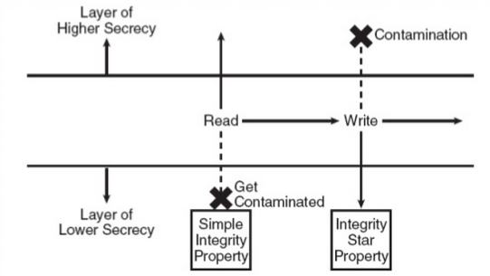
Biba Integrity Model
Simple integrity: modify only if I(S) ≥ I(O)
Integrity confinement: read only if I(S) ≤ I(O)
Invocation property: invoke/comm only if I(S₁) ≥ I(S₂)
Notes:
The Biba [BIBA77] models deals with integrity, and is concerned with the unauthorized modification of data. The basic elements of the Biba model are like the BLP model. As with BLP, the Biba model deals with subjects and objects. Each subject and object is assigned an integrity level, denoted as I(S) and I(O) for subject S and object O, respectively. A simple hierarchical classification can be used, in which there is a strict ordering of levels from lowest to highest. Biba then proposes a number of alternative policies that can be imposed on this model. The most relevant is the strict integrity policy, based on the following rules:
• Simple integrity: A subject can modify an object only if the integrity level of the subject dominates the integrity level of the object: I(S) ≥ I(O).
• Integrity confinement: A subject can read on object only if the integrity level of the subject is dominated by the integrity level of the object: I(S) ≤ I(O).
• Invocation property: A subject can invoke another subject only if the integrity level of the 1st subject dominates the integrity level of the 2nd subject: I(S₁) ≥ I(S₂).
The simple integrity rule is the logical write-up restriction that prevents contamination of high-integrity data. Figure 10.4 illustrates the need for the integrity confinement rule. A low-integrity process may read low-integrity data but is prevented from contaminating a high-integrity file with that data by the simple integrity rule. If only this rule is in force, a high-integrity process could conceivably copy low-integrity data into a high-integrity file. Normally, one would trust a high-integrity process to not contaminate a high-integrity file, but an error in the code or a Trojan horse could result in such contamination. Hence the need for the integrity confinement rule.

Slide 74
Clark-Wilson Integrity Model
Two concepts
Well-formed transactions: a user can manipulate data in constrained ways
Separation of duty: one can create a transaction but not execute it
CDI: constrained data items (loan app; checks)
UDI: unconstrained items
IVPs: procedures that assure all CDIs conform to integrity/consistency rules
TPs: transactions that change CDIs
Very practical; used in commercial world
Notes:
The Biba [BIBA77] models deals with integrity, and is concerned with the unauthorized modification of data. The basic elements of the Biba model are like the BLP model. As with BLP, the Biba model deals with subjects and objects. Each subject and object is assigned an integrity level, denoted as I(S) and I(O) for subject S and object O, respectively. A simple hierarchical classification can be used, in which there is a strict ordering of levels from lowest to highest. Biba then proposes a number of alternative policies that can be imposed on this model. The most relevant is the strict integrity policy, based on the following rules:
• Simple integrity: A subject can modify an object only if the integrity level of the subject dominates the integrity level of the object: I(S) ≥ I(O).
• Integrity confinement: A subject can read on object only if the integrity level of the subject is dominated by the integrity level of the object: I(S) ≤ I(O).
• Invocation property: A subject can invoke another subject only if the integrity level of the 1st subject dominates the integrity level of the 2nd subject: I(S₁) ≥ I(S₂).
The simple integrity rule is the logical write-up restriction that prevents contamination of high-integrity data. Figure 10.4 illustrates the need for the integrity confinement rule. A low-integrity process may read low-integrity data but is prevented from contaminating a high-integrity file with that data by the simple integrity rule. If only this rule is in force, a high-integrity process could conceivably copy low-integrity data into a high-integrity file. Normally, one would trust a high-integrity process to not contaminate a high-integrity file, but an error in the code or a Trojan horse could result in such contamination. Hence the need for the integrity confinement rule.

Slide 75
Certified and Enforcement Rules
C1: IVPs must ensure that all CDIs are in valid states
C2: All TPs must be certified (must take a CDI from a valid state to a valid final state)
(Tpi, CDIa, CDIb, CDIc, …)
E1: The system must maintain a list of relations specified in C2
E2: The system must maintain a list of (User, Tpi, (CDIa, CDIb, …))

Slide 76
Certified and Enforcement Rules
C3: The list of relations in E2 must be certified to meet separation of duties
E3 The system must authenticate each user when executing a TP
C4: All TPs must be certified
C5: Any TP that takes UDI as in input value must be certified to perform valid transaction
E4: Only the agent permitted to certify entitles is allowed to do so

Slide 77
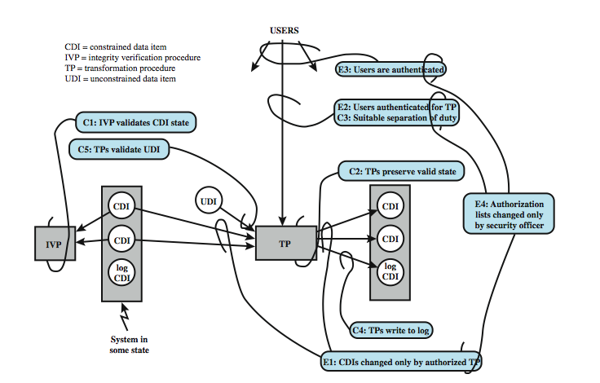
Clark-Wilson Integrity Model
Certification (C) and
Enforcement (E) rules
Notes:
A more elaborate and perhaps more practical integrity model was proposed by Clark and Wilson. The Clark-Wilson model (CWM) is aimed at commercial rather than military applications, and closely models real commercial operations. Figure 10.5 illustrates the rules in this model. The rules combine to form a two-part integrity assurance facility, in which certification is done by a security officer with respect to an integrity policy, and enforcement is done by the system. The rules are:
Cl: All IVPs must ensure all CDIs are in a valid state at the time the IVP is run.
C2: All TPs must be certified to be valid.
El: system must maintain a list of relations from C2, and must ensure manipulation of any CDI is by a TP,as specified in some relation.
E2: system must maintain a list of relations of the form: (UserID, TPi, (CDIa, CDIb, CDIc, . ..)), which relates a user, a TP, and data objects that TP may reference.
C3: list of relations in E2 must be certified to meet the separation of duty requirement.
E3: system must authenticate the identity of each user attempting to execute a TP.
C4: All TPs must be certified to write to an append-only CDI (the log) all info.
C5: Any TP that takes a UDI as an input value must be certified to perform only valid transformations, or else no transformations, for any possible value of the UDI.
E4: Only the agent permitted to certify entities may change the list of such entities associated with other entities.
See text for further details.

Slide 78
The Chinese Wall Model
Hybrid model: addresses integrity and confidentiality
Addresses conflict of interest (CI or CoI)
Model elements
subjects: active entities interested in accessing protected objects
information
objects: individual data items, each about a corp
datasets (DS): all objects concerning one corp
CI class: datasets whose corp are in competition (conflict of interest or CI)
access rules: rules for reading/writing data
Notes:
The Biba [BIBA77] models deals with integrity, and is concerned with the unauthorized modification of data. The basic elements of the Biba model are like the BLP model. As with BLP, the Biba model deals with subjects and objects. Each subject and object is assigned an integrity level, denoted as I(S) and I(O) for subject S and object O, respectively. A simple hierarchical classification can be used, in which there is a strict ordering of levels from lowest to highest. Biba then proposes a number of alternative policies that can be imposed on this model. The most relevant is the strict integrity policy, based on the following rules:
• Simple integrity: A subject can modify an object only if the integrity level of the subject dominates the integrity level of the object: I(S) ≥ I(O).
• Integrity confinement: A subject can read on object only if the integrity level of the subject is dominated by the integrity level of the object: I(S) ≤ I(O).
• Invocation property: A subject can invoke another subject only if the integrity level of the 1st subject dominates the integrity level of the 2nd subject: I(S₁) ≥ I(S₂).
The simple integrity rule is the logical write-up restriction that prevents contamination of high-integrity data. Figure 10.4 illustrates the need for the integrity confinement rule. A low-integrity process may read low-integrity data but is prevented from contaminating a high-integrity file with that data by the simple integrity rule. If only this rule is in force, a high-integrity process could conceivably copy low-integrity data into a high-integrity file. Normally, one would trust a high-integrity process to not contaminate a high-integrity file, but an error in the code or a Trojan horse could result in such contamination. Hence the need for the integrity confinement rule.

Slide 79
The Chinese Wall Model
Not a true multilevel secure model
the history of a subject’s access determines access control
Subjects are only allowed access to info that is not held to conflict with any other info they already possess
Once a subject accesses info from one dataset, a wall is set up to protect info in other datasets in the same CI
Notes:
The Biba [BIBA77] models deals with integrity, and is concerned with the unauthorized modification of data. The basic elements of the Biba model are like the BLP model. As with BLP, the Biba model deals with subjects and objects. Each subject and object is assigned an integrity level, denoted as I(S) and I(O) for subject S and object O, respectively. A simple hierarchical classification can be used, in which there is a strict ordering of levels from lowest to highest. Biba then proposes a number of alternative policies that can be imposed on this model. The most relevant is the strict integrity policy, based on the following rules:
• Simple integrity: A subject can modify an object only if the integrity level of the subject dominates the integrity level of the object: I(S) ≥ I(O).
• Integrity confinement: A subject can read on object only if the integrity level of the subject is dominated by the integrity level of the object: I(S) ≤ I(O).
• Invocation property: A subject can invoke another subject only if the integrity level of the 1st subject dominates the integrity level of the 2nd subject: I(S₁) ≥ I(S₂).
The simple integrity rule is the logical write-up restriction that prevents contamination of high-integrity data. Figure 10.4 illustrates the need for the integrity confinement rule. A low-integrity process may read low-integrity data but is prevented from contaminating a high-integrity file with that data by the simple integrity rule. If only this rule is in force, a high-integrity process could conceivably copy low-integrity data into a high-integrity file. Normally, one would trust a high-integrity process to not contaminate a high-integrity file, but an error in the code or a Trojan horse could result in such contamination. Hence the need for the integrity confinement rule.

Slide 80
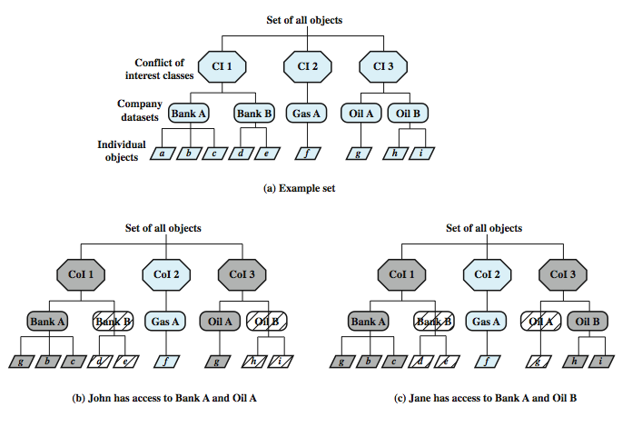
Chinese Wall Model
Simple sec rule (read): S can
read O if O is in the same DS as
an object already accessed by S
OR O belongs to a CoI from which
S has not yet accessed any info
*-property (write): S can write
O only if S can read O and all objects
that S can read are in the same DS
as O.
Question: what can John or
Jane write to?
Notes:
The Chinese Wall Model (CWM) takes a quite different approach to specifying integrity and confidentiality than any of the approaches we have examined so far. The model was developed for commercial applications in which conflicts of interest can arise. The principal idea behind the CWM is the use of a Chinese wall to prevent a conflict of interest. Figure 10.6a gives an example. There are datasets representing banks, oil companies, and gas companies. All bank datasets are in one CI, all oil company datasets in another CI, and so forth. In contrast to the models we have studies so far, the history of a subject's previous access determines access control. The basis of the Chinese wall policy is that subjects are only allowed access to information that is not held to conflict with any other information that they already possess. Once a subject accesses information from one dataset, a wall is set up to protect information in other datasets in the same CI. The subject can access information on one side of the wall but not the other side. Further, information in other CIs is initially not considered to be on one side or the other of the wall but out in the open. When additional accesses are made in other CIs by the same subject, the shape of the wall changes to maintain the desired protection. Further, each subject is controlled by his or her own wall - the walls for different subjects are different. To enforce this, two rules are needed:
Simple security rule: A subject S can read on object O only if: O is in the same DS as an object already accessed by S, or O belongs to a CI from which S has not yet accessed any information. Figure 10.6b and c illustrate the operation of this rule.
*-property rule: A subject S can write an object O only if: S can read O according to the simple security rule, and All objects that S can read are in the same DS as O. Thus, in Figure 10.6, neither John nor Jane has write access to any objects.

Slide 81
CW-*-Property
s can write to o iff both of the following hold:
The CW-simple condition permits s to read o
For all unsanitized objects o′, if s can read o′, then CD (o′) = CD (o)
All s can read are either within the same CD, or sanitized
Alice
Bob
Neither Alice nor bob can write
Bank
Gasoline
Citibank
Bank of America
Bank of the West
Shell
Mobil
Sunoco
Texaco

Slide 82
How Does Information Flow?
With the two conditions (CW simple security condition and CW *-property) in place, how can information flow around the system?
Main Results
In each COI class (e.g. Bank), a subject can only read objects in a single CD (e.g. Citibank)
At least n subjects are required to access all objects in a COI class with totally n CDs

Slide 83
How Does Information Flow? (Cont’d)
Information flows from o to o’ if s reads o and writes o’
information in an unsanitized object can only flow inside that CD; information in sanitized objects can flow freely
Citibank
Bank of America
Bank of the West
Shell
Mobil
Sunoco
Texaco
o₃
o₁
o₂
o₃
sanitized
o₁
o₂
o₃
unsanitized

Slide 84
Compare CW to Bell-LaPadula
CW is based on access history, BLP is history-less
BLP can capture CW state at any time, but cannot track changes over time
BLP security levels would need to be updated each time an access is allowed

