Slide 1
Module 1: Pre-requisites in Information and Network Security
Chapter 2: Information Security Overview: Background and Current Scenario

Slide 2
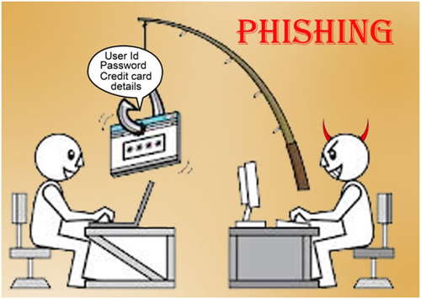

Slide 3
Types of Attack
Phishing:
Phishing is the attempt to acquire sensitive information such as usernames, passwords, and credit card details (and sometimes, indirectly, money), often for malicious reasons, by masquerading as a trustworthy entity in an electronic communication.
Phishing takes advantage of the trust that the user may not be able to tell that the site being visited, or program being used, is not real; therefore, when this occurs, the hacker has the chance to gain the personal information of the targeted user, such as passwords, usernames, security codes, and credit card numbers, among other things.

Slide 4
Types of Attack
Example: Most methods of phishing use some form of technical deception designed to make a link in an email (and the spoofed website it leads to) appear to belong to the spoofed organization.
Misspelled URLs or the use of sub domains are the common tricks used by phishers.
In the following example URL, http://www.yourbank.example.com/, it appears as though the URL will take you to your bank website; actually this URL points to a phishing site which looks as your original bank website. The user is then asked for his credentials by phishing website to gain sensitive information.

Slide 5
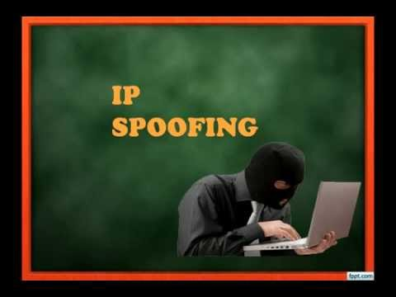

Slide 6
Spoofing
Many of the protocols in the TCP/IP suite do not provide mechanisms for authenticating the source or destination of a message.
They are thus vulnerable to spoofing attacks when extra precautions are not taken by applications to verify the identity of the sending or receiving host.
IP spoofing and ARP spoofing in particular may be used to leverage man-in-the-middle attacks against hosts on a computer network.
Spoofing attacks which take advantage of TCP/IP suite protocols may be mitigated with the use of firewalls capable of deep packet inspection or by taking measures to verify the identity of the sender or recipient of a message.

Slide 7
Spoofing
Spoofing:
Spoofing is the creation of TCP/IP packets using somebody else's IP address.
Routers use the "destination IP" address in order to forward packets through the Internet, but ignore the "source IP" address.
That address is only used by the destination machine when it responds back to the source.
Example: Hackers will use spoofing mechanism to avoid getting tracked by routers while making an attack.

Slide 8
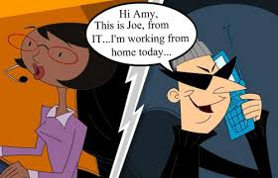
Impersonation

Slide 9
Types of Attack
Impersonation
It is an act of pretending to be another person for the purpose of fraud. It can be done via any communication mechanism like phone, email etc.
Example: An Impersonator calling victim and claims that he is calling from the bank where victim has account. He will ask for account details, passwords etc. in claiming that he is asking for the information for verification. In reality he will use the information to make fraudulent transactions.

Slide 10
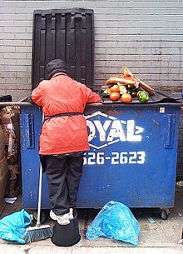
Dumpster Diving : Searching from Trash/Garbage

Slide 11
Dumpster Diving
In the world of information technology, dumpster diving is a technique used to retrieve information that could be used to carry out an attack on a computer network.
Dumpster diving isn't limited to searching through the trash for obvious treasures like access codes or passwords written down on sticky notes.
In the computer world, dumpster diving refers to using various methods to get information about a technology user.
In general, dumpster diving involves searching through trash or garbage looking for something useful.
This is often done to uncover useful information that may help an individual get access to a particular network.
So, while the term can literally refer to looking through trash, it is used more often in the context of any method (especially physical methods) by which a hacker might look for information about a computer network.

Slide 12
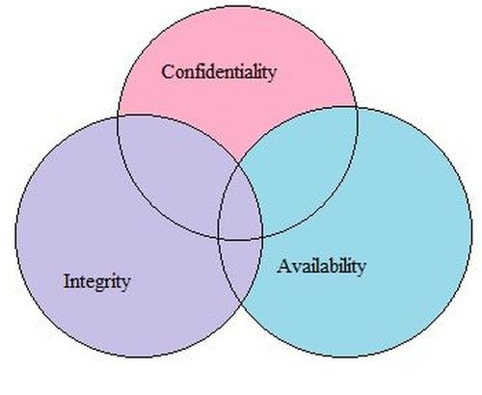
Goals for Security

Slide 13
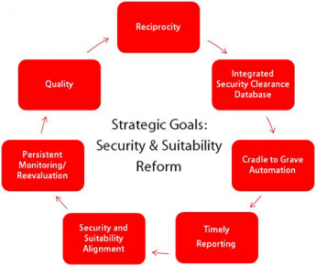
Goals for Security

Slide 14
Goals for Security
The following are the key security goals
Integrity - Making sure that the behaviour of the system under test cannot be changed maliciously
Confidentiality - Making sure that the system does not leak sensitive information and does not allow illegitimate users to access the system
Non-repudiation - Ability of the system to be able to "prove" that certain actions actually happened
Availability - Making sure that the system continues to remain available in the face of attacks
Access Control - Users should not be allowed to perform actions beyond their permitted role

Slide 16
E-Commerce Security
Ecommerce entails buying/selling of products over the internet and has gain popularity in the recent years.
Security is an essential part of any transaction that takes place over the internet.
Customer will lose his/her faith in e-business if its security is compromised.
Following are the essential requirements for safe ecommerce website:

Slide 17
E-Commerce Security
1.Choose a secure ecommerce platform: Choose a strongly typed higher level language for the development. If open source tools/libraries are used then ensure that the frameworks does not create security holes in your application
2. Use a secure connection for online checkout--and make sure you are PCI compliant: Always use HTTPs protocol for all important transactions.
3. Don't store sensitive data: As part of the website, there is no need to store sensitive information like CVV number and other credit card information
4. Set up system alerts for suspicious activity: Build a system that alerts when an undesired event happens in the system. Multiple requests from the same IP for long periods of time can indicate malicious intent

Slide 18
E-Commerce Security
5.Layer your security: Defense in depth is absolutely needed in ecommerce domain. Security features like multiple passwords and OTP helps in reducing the risk of hacking
6. Provide security training to employees: If the employees understand the importance of security then human error can be avoided
7. Patch your systems: New security loop holes are discovered on a daily basis. If the system is not up to date then risk of getting hacked increases exponentially
8. Make sure you have a Distributed Denial of Service (DDoS) protection and mitigation service: Have a mitigation strategy against network denial of service attack and block IPs that are sending lot of request to the system
9. Disaster recovery plan: Plan for unlikely failure of your system. In case of system failure ensure that sensitive data is not lost or corrupted by the system

Slide 19
Computer Forensics

Slide 20
Computer Forensics
Computer forensics is a branch of digital forensic science pertaining to evidence found in computers and digital storage media.
The goal of computer forensics is to examine digital media in a forensically sound manner with the aim of identifying, preserving, recovering, analyzing and presenting facts and opinions about the digital information

Slide 21
Computer Forensics
At a high level following are the guidelines used to process the evidence in computer forensic:

Slide 22
Computer Forensics
Step 1: Shut down the computer. Considerations must be given to volatile information. Prevents remote access to machine and destruction of evidence (manual or ant-forensic software)
Step 2: Document the Hardware Configuration of the System. Note everything about the computer configuration prior to re-locating
Step 3: Transport the Computer System to A Secure Location. Do not leave the computer unattended unless it is locked in a secure location
Step 4: Make Bit Stream Backups of Hard Disks and Floppy Disks
Step 5: Mathematically Authenticate Data on All Storage Devices. Must be able to prove that you did not alter any of the evidence after the computer came into your possession

Slide 23
Computer Forensics
Step 6: Document the System Date and Time
Step 7: Make a List of Key Search Words
Step 8: Evaluate the Windows Swap File
Step 9: Evaluate File Slack. File slack is a data storage area of which most computer users are unaware; a source of significant security leakage.
Step 10: Evaluate Unallocated Space (Erased Files)
Step 11: Search Files, File Slack and Unallocated Space for Key Words
Step 12: Document File Names, Dates and Times
Step 13: Identify File, Program and Storage Anomalies
Step 14: Evaluate Program Functionality
Step 15: Document Your Findings
Step 16: Retain Copies of Software Used

Slide 24
Computer Forensics
Where Computer forensic is used?
a. Criminal prosecution
b. Insurance companies
c. Law enforcement

Slide 25
Steganography
Steganography (pronounced STEHG-uh-NAH-gruhf-ee, from Greek steganos, or "covered," and graphie, or "writing") is the hiding of a secret message within an ordinary message and the extraction of it at its destination.
Steganography is the practice of concealing a file, message, image, or video within another file, message, image, or video. For example, the hidden message may be in invisible ink between the visible lines of a private letter.

Slide 26
Steganography
Some of the earlier examples of steganography are:
Hidden messages on messenger's body—also used in ancient Greece. Herodotus tells the story of a message tattooed on the shaved head of a slave of Histiaeus, hidden by the hair that afterwards grew over it, and exposed by shaving the head. The message allegedly carried a warning to Greece about Persian invasion plans. This method has obvious drawbacks, such as delayed transmission while waiting for the slave's hair to grow, and restrictions on the number and size of messages that can be encoded on one person's scalp.
In the early days of the printing press, it was common to mix different typefaces on a printed page due to the printer not having enough copies of some letters in one typeface. Because of this, a message could be hidden using two (or more) different typefaces, such as normal or italic.

Slide 27
Steganography
In digital steganography, electronic communications may include steganographic coding inside of a transport layer, such as a document file, image file, program or protocol. Media files are ideal for steganographic transmission because of their large size. For example, a sender might start with an innocuous image file and adjust the color of every 100th pixel to correspond to a letter in the alphabet, a change so subtle that someone not specifically looking for it is unlikely to notice it.

Slide 29
Steganography

Slide 30
Steganography
The above is a classic example of steganography where the left tree image is hiding the right image and the hidden image is revealed by removing all but the two least significant bits of each color component and a subsequent normalization.

